Slide 1

Implementation of Dutch Farming for the Cultivation of Tomatoes in South India
Professor. Michele Monno
Sowmya Palanichamy
2025-2026
Notes:
Good morning respected jury members. My name is Sowmya Palanichamy, and today I’m going to present my thesis titled “Implementation of Dutch Farming for the Cultivation of Tomatoes in South India.” This work was carried out in collaboration with Agro Tie India, a company working in the horticulture and agriculture sector

Slide 2
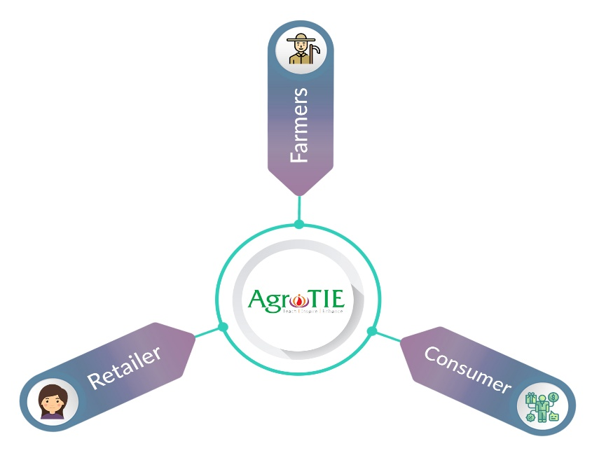
Company Overview
This thesis has been developed in collaboration with Agro Tie India.
Company sector → Horticulture and Agriculture sector.
Passive Hydroponics
Protected Structure
Greenhouse Technology
Seedling and crop management
Business model:
Sustainable Food Production → Passive Hydroponic Systems for Tropical Climate.

Slide 3

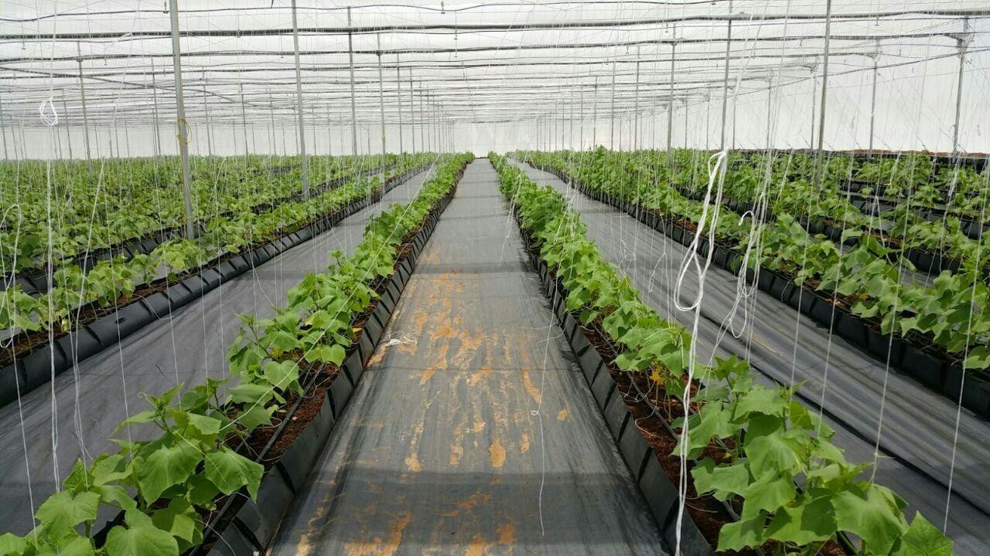
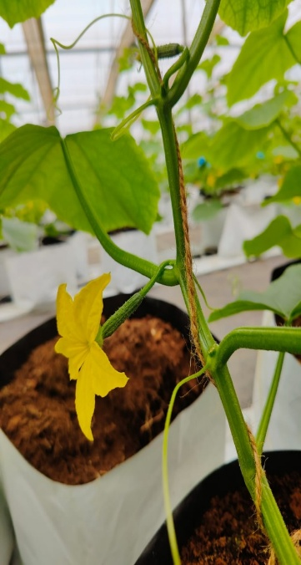
Thesis Objective
OBJECTIVE:
To develop and evaluate innovative Dutch farming techniques for tomatoes in South India, and analyze their impact on yield, resource efficiency, and crop quality.

Slide 4
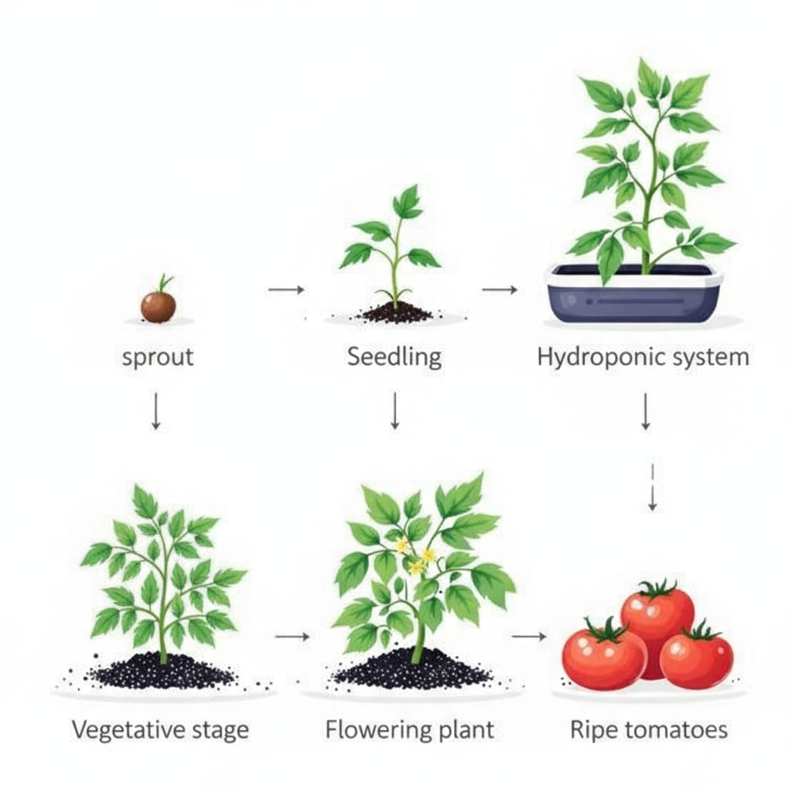
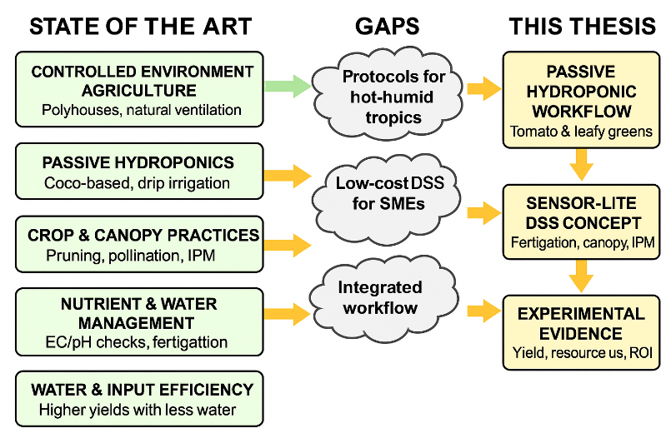
Thesis Motivation
WHY:
Critical Challenges in South Indian Agriculture which includes climate change impacts, water scarcity, and limited arable land.
Traditional farming struggles with low yields, pest and disease pressures, and resource constraints.
Goal: To develop sustainable farming solutions through passive hydroponics integrated within protected cultivation structures, enabling year-round production of tomatoes and leafy vegetables (like lettuce, spinach, and basil), while supporting small and medium-scale farmers in South India by improving pest management, enhancing crop quality and yield, and addressing resource limitations through efficient water and nutrient use.

Slide 5
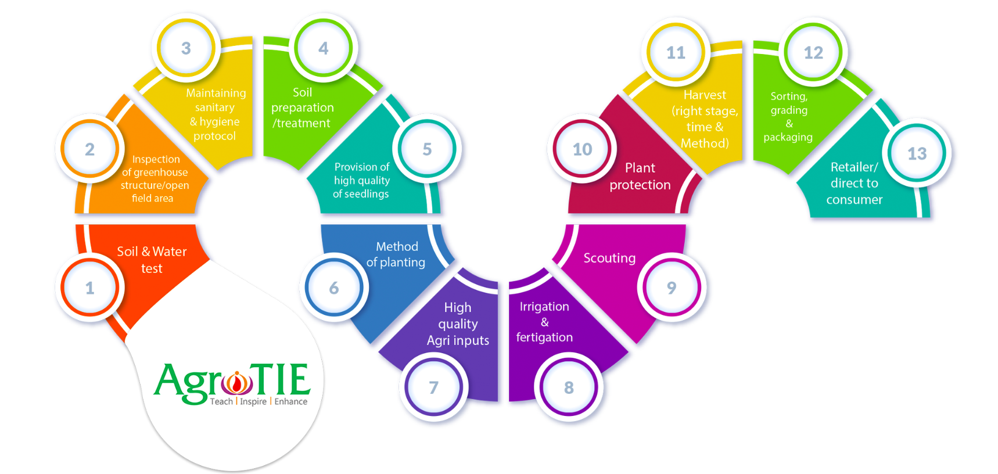
Thesis Motivation
HOW:
Integration and to develop a sustainable passive hydroponic system optimized for South India’s climate, enhancing yield, resource efficiency, and farmer sustainability.
→ Output: Sustainable passive hydroponic model

Slide 6
Research Objectives
Primary Objectives
Design and implement a passive hydroponic system specifically adapted for South India’s tropical climate conditions.
Evaluate and optimize Dutch farming techniques for tomato cultivation in South Indian context.
Assess resource efficiency metrics: 70-90% water savings and 60% nutrient use reduction compared to conventional methods.
Secondary Objectives
Support small and medium-scale farmers through accessible technology transfer and training programs.
Enable year-round production of high-value tomato varieties despite seasonal climate variations.
Analyze economic viability and sustainability with target ROI of 30-40% after establishment phase.
Notes:
For example

Slide 7
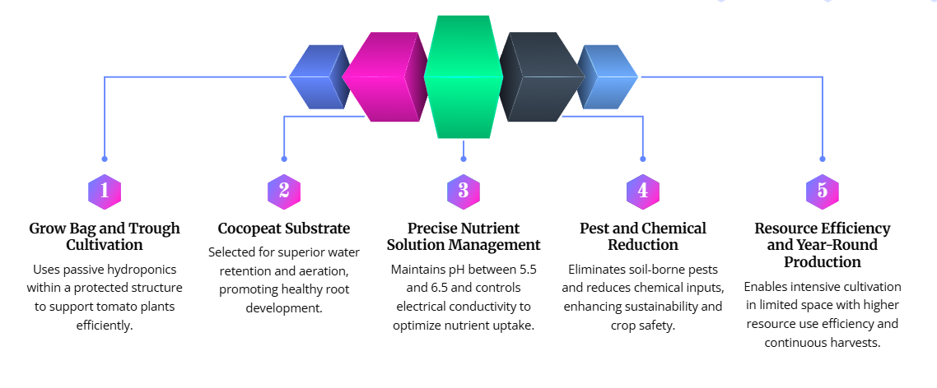
Methodology – Workflow

Slide 8
Methodology - Workflow
Problem identification and objective definition
System design and setup
Crop selection
Nutrient and irrigation optimization
Decision support system (DSS) and development
Data analysis and evaluation in system
Growth monitoring and data collection
Cultivation and management

Slide 9

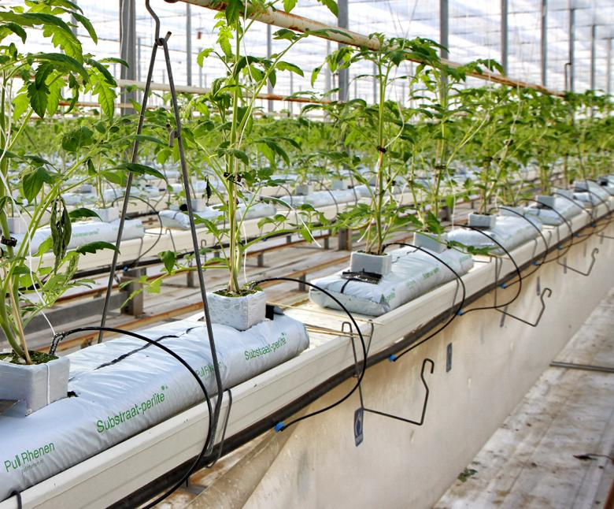






Methodology Overview
Overview of the systematic approach :
Greenhouse design
hydroponic system setup
nursery establishment
crop selection
workflow
nutrient climate management.

Slide 10
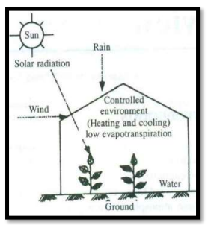
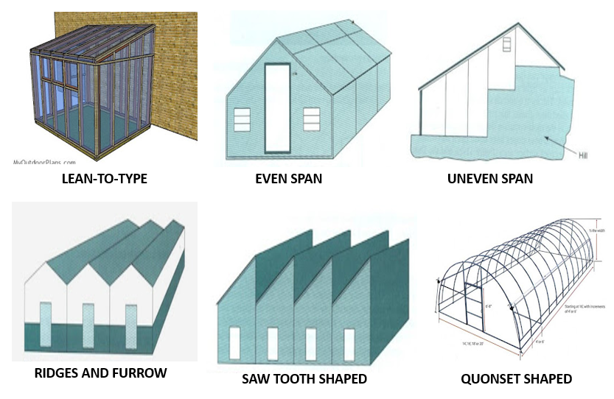
System Design - Protected Cultivation Structure
Greenhouse Specifications
Dimensions: 50m x 50m (2500 sq.m)
UV-stabilized polyethylene cover (205N thickness)
Insect netting (40-micron mesh)
Gutter height: 4-4.5m
Climate Control Features
High-efficiency exhaust fans
Fogger system for humidity control
Automated ventilation systems
Shade nets (50%)
Economic Aspects
Total cost estimate - ₹35-36 lakhs for 4000 sq.m facility.
Structure lifespan - 15-20 years with proper maintenance.
Notes:
Greenhouse Specifications
Dimensions: 50m x 50m (2500 sq.m), naturally ventilated design.
UV-stabilized polyethylene cover (205N thickness) for controlled light transmittance.
Insect netting (40-micron mesh) around structure for pest exclusion.
Gutter height: 4-4.5m, optimized for enhanced air circulation
Climate Control Features
High-efficiency exhaust fans positioned strategically for air movement.
Fogger system for humidity control during dry periods.
Automated ventilation systems for temperature regulation.
Shade nets (50%) deployable during peak summer months
Economic Aspects.
Total cost estimate: ₹35-36 lakhs for 4000 sq.m facility.
Structure lifespan: 15-20 years with proper maintenance.
Modular design allows phased implementation for small farmers.
40-50% subsidy available through government schemes.

Slide 11
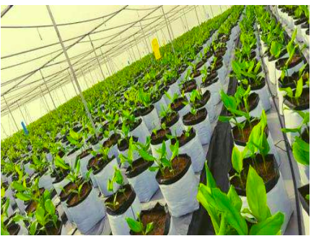
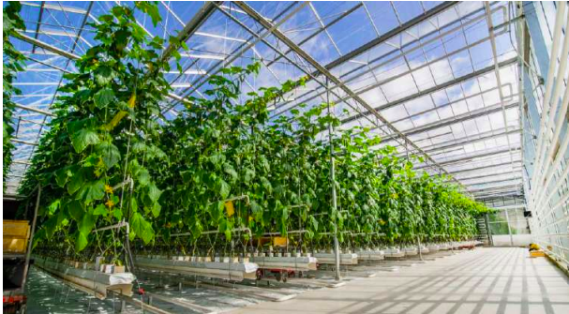
Passive Hydroponic System
Growing Medium & Container System
Cocopeat (EC <0.5 mS/cm, pH 5.5-6.5).
Grow bag system (30cm x 15cm) with optimal drainage holes.
Plant density: 2.5 plants/m2 (10,000 plants/acre).
Irrigation & Fertigation Setup
Fertigation tanks for balanced nutrient delivery.
Automated drip lines.
Drainage collection and EC/pH monitoring system for recycling.
System Advantages
90% water savings
Complete elimination of soil-borne diseases and pathogens.
Precise control over root zone environment and nutrient uptake.
Notes:
Growing Medium & Container System
Cocopeat as primary growing medium (EC <0.5 mS/cm, pH 5.5-6.5).
Grow bag system (30cm x 15cm) with optimal drainage holes.
Plant density: 2.5 plants/m2 (10,000 plants/acre).
100% biodegradable medium for environmental sustainability.
Irrigation & Fertigation Setup
A and B tank fertigation system for balanced nutrient delivery.
Automated drip lines with 2L/hour emitters (4 lines per grow bag).
Precision irrigation control based on growth stage requirements.
Drainage collection and EC/pH monitoring system for recycling.
System Advantages
70-90% water savings compared to traditional farming.
Complete elimination of soil-borne diseases and pathogens.
Precise control over root zone environment and nutrient uptake.
Reduced fertilizer runoff and environmental contamination.

Slide 12
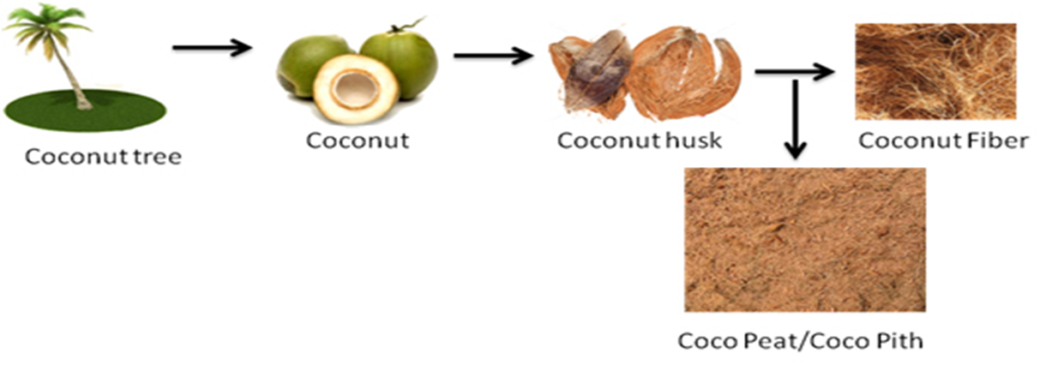
Growing Medium
Area | Benefit
Water Efficiency | Up to 60% improvement in water retention; cucumber farms cut water use by 30%
Crop Yield | 15–25% higher yields (example: strawberry farm saw 20% yield boost)
Root Growth | Roots grow 15% faster in coco peat than soil—better nutrient absorption
Sustainability | Husks are renewable, non-toxic, lightweight, and reduce agri-waste
Disease Resistance | Cocopeat has antifungal properties; reduces soil-borne disease incidence
Economic Impact | Faster crop cycles, up to 1 year sooner payback; savings in fertilizer and irrigation
Coconut husk hydroponics promote circular resource use, turning agricultural waste into valuable farming resources, thereby lowering the environmental footprint and aligning with government ESG (Environmental, Social, Governance) and sustainability goals

Slide 13
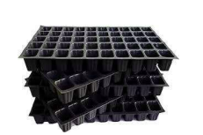
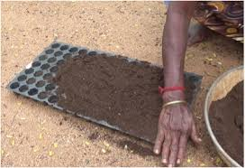
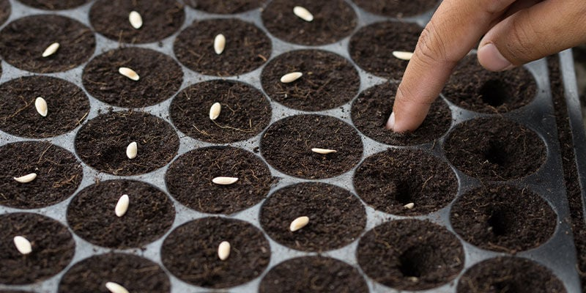
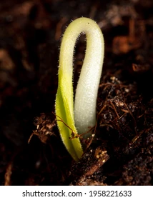
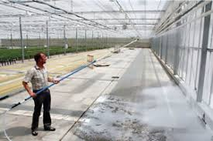
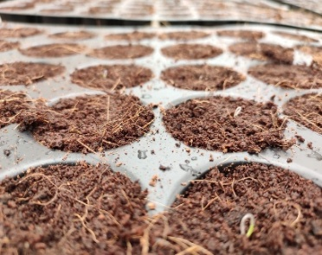
Nursery Establishment
Phase 1: Pro-tray System
Multiple cavity options - Smaller cavity or Larger cavity count
Sterilized plastic trays ensure disease-free environment.
Germination & Sanitization
Initial germination in controlled dark room for 2-3 days.
Seed treatment with Profenofos and Lambda cyhalothrin.
Climate control and sanitization protocols to prevent disease
Notes:
Phase 1Pro-tray System
Multiple cavity options: 36, 50, 72, and 98 cells per tray.
Smaller cavity count (36-50) produces sturdier seedlings.
Larger cavity count (72-98) maximizes space efficiency·
Sterilized plastic trays ensure disease-free environment.
Germination & Sanitization
Initial germination in controlled dark room for 2-3 days.
Seed treatment with Profenofos and Lambda cyhalothrin.
Strict sanitization protocols to prevent disease introduction.
Climate control: 25-26C temperature, 55-60% relative humidity.
Development Timeline
Germination period: 5-8 days for tomato seeds.
Root development stage: 10-15 days post-germination.
True leaf formation: 15-20 days.
Transplanting readiness: 25-30 days for tomatoes.
Hardening period: 3-5 days before transplant to growing bags.
Optimal Climate Conditions.
Temperature range: 21-30C (optimal for tomato development).
Relative humidity: 60-65% (reduces disease pressure).
Light intensity: 600-800 µmol/m²/s (supplemental lighting in cloudy periods).
Climate Control Solutions
High-pressure foggers for humidity and cooling during summer.
Shade nets (30-50%) for extreme radiation periods.
Circulation fans for uniform air movement (0.5-0.7 m/s).
Natural ventilation with automated roof openings.

Slide 14
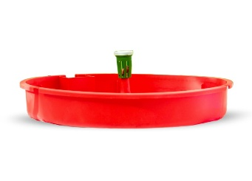
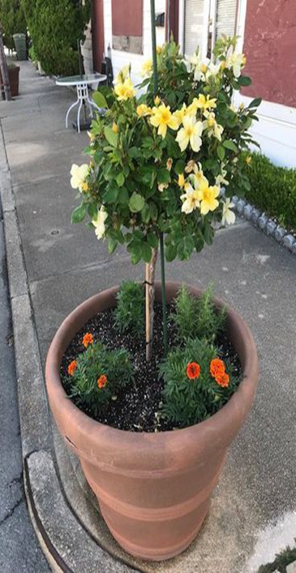
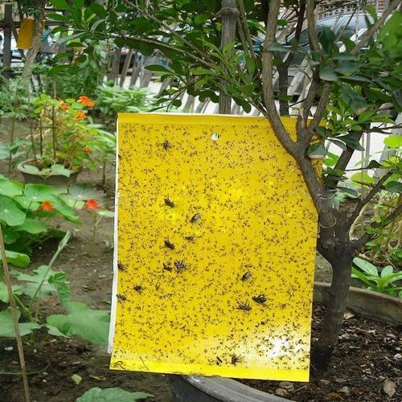
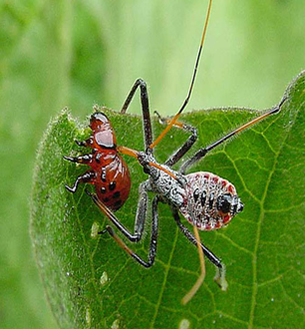
Pest Management
Integrated Pest Management (IPM)
Yellow and blue sticky traps for monitoring pest populations.
Biological controls: Trichoderma for root health, Pseudomonas for disease suppression.
Chemical interventions (minimal): Imidacloprid, Spinosad, Abamectin.
Regular crop walks (3x/week) for early pest and disease detection.
Strict sanitation protocols between crop cycles to prevent carryover.

Slide 15
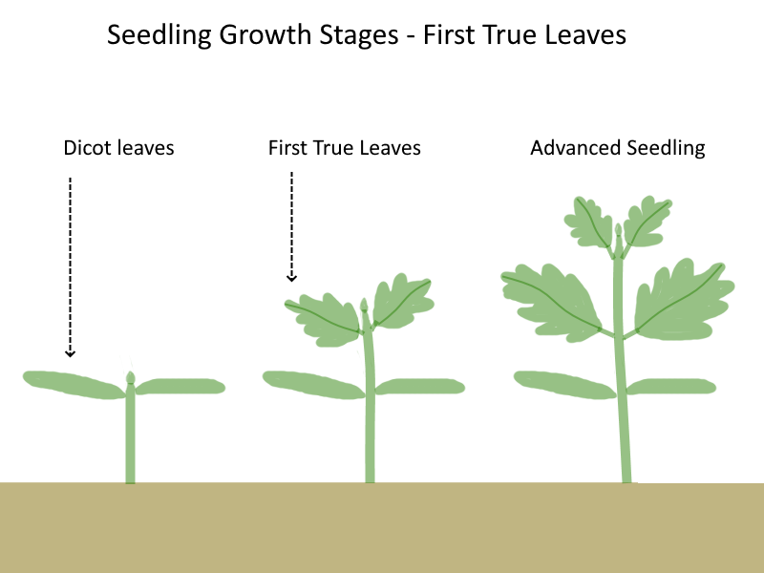

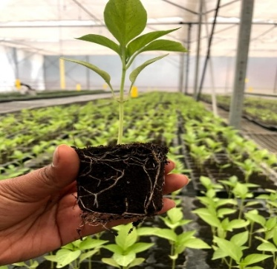
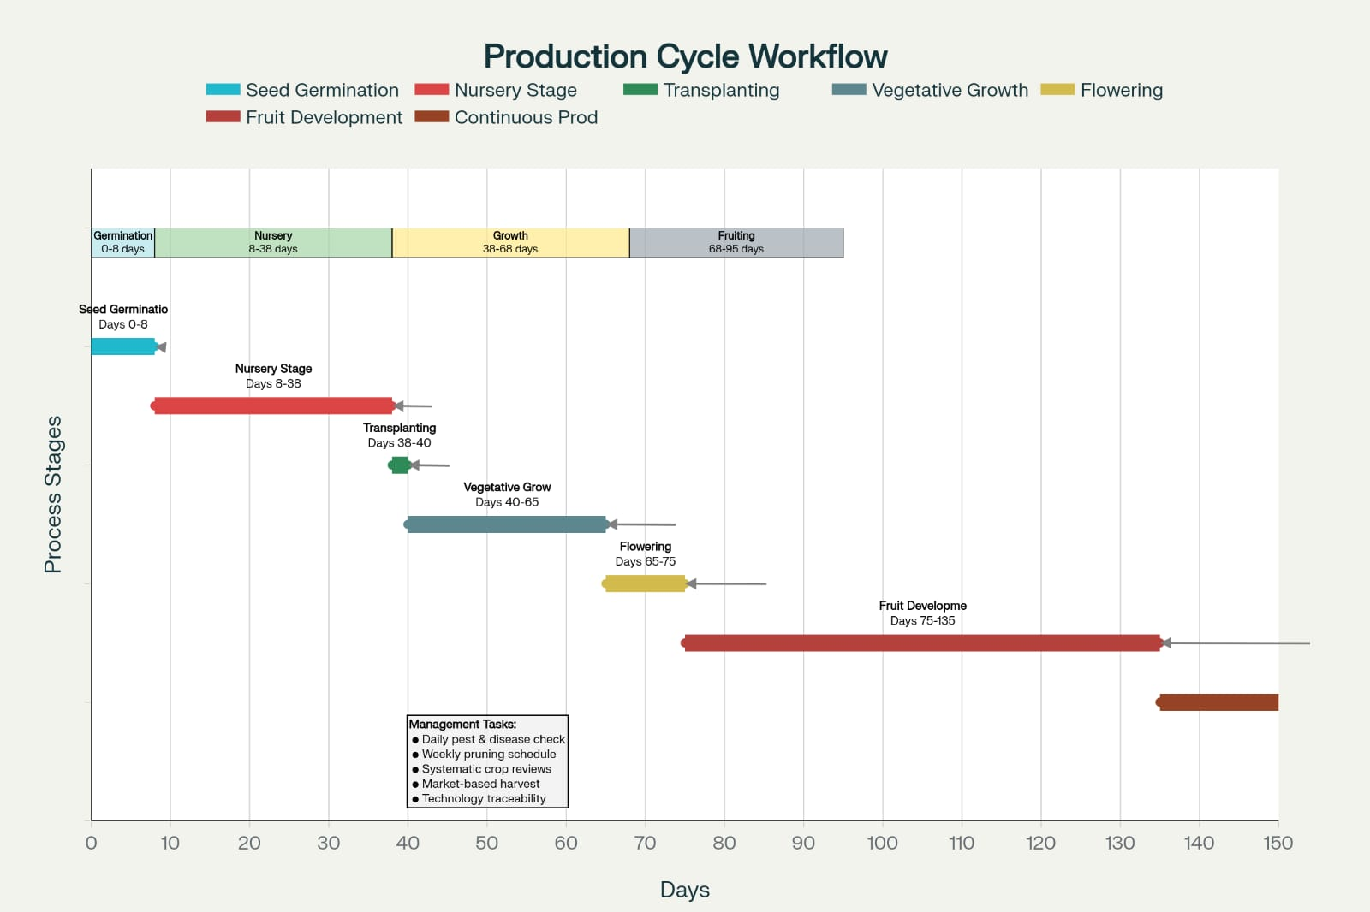
PRODUCTION CYCLE
Seed Germination (5-8 days)
Controlled environment: 25-26°C, 80-85% humidity in dark room.
Nursery Stage (25-30 days)
Seedling development in pro-trays with regular nutrition and monitoring.
Transplanting to Grow Bags
Careful transfer to cocopeat bags with minimal root disturbance.
Vegetative Growth with Fertigation
EC 1.5-2.2, regular monitoring, plant training and pruning.
Flowering & Pollination
Manual vibration or electric pollinators, EC 2.2-2.4.
Fruit Development & Harvest (60 days post-transplant)
EC 2.8-3.0, grade-based harvesting for optimal quality.

Slide 16
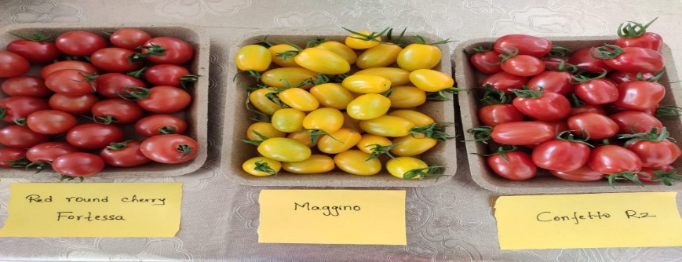
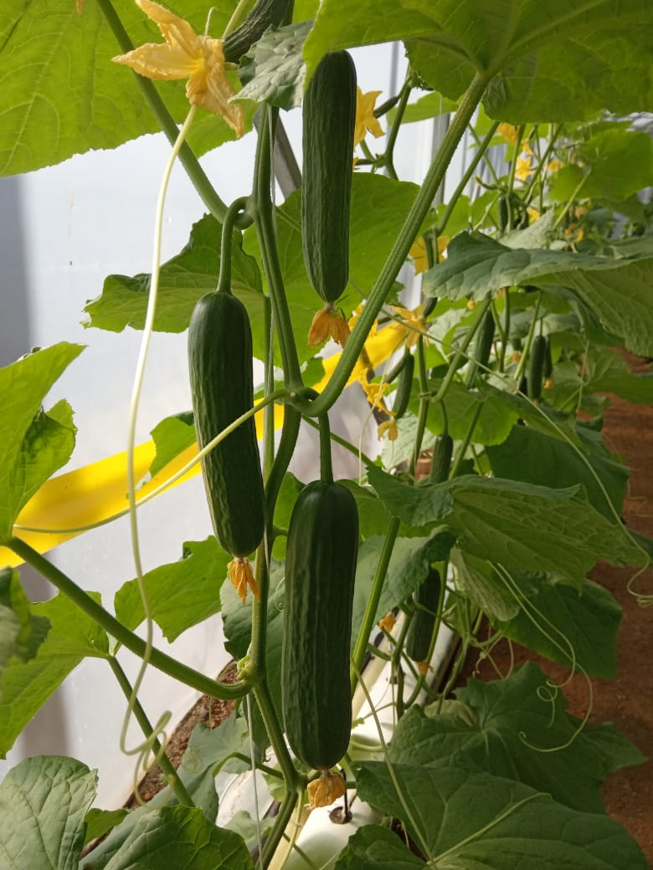
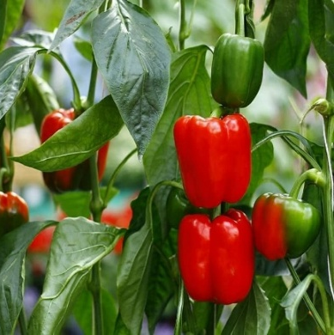
Crop Selection & Varieties
Selection Criteria
Market demand: Premium prices for consistent quality and size.
Climate suitability: Varieties adaptable to controlled environments.
Yield potential: Productivity per square meter of greenhouse space.
Disease resistance: Especially against common greenhouse pathogens.
Tomato Varieties for Hydroponic Cultivation
Beefsteak (Valouro): 180-200g/fruit - Ideal for slicing, robust flavor profile, excellent market value.
Intermediate Cluster (Cibellia, Disten): 140-160g/fruit - Extended shelf life, uniform ripening, disease resistance.
Cherry Tomatoes (Maggino, Fortesa): 14-16g/fruit - High sugar content, excellent for local markets, continuous production.
*Complimentary crops: Cucumber, lettuce, spinach, bell pepper, and basil.
Notes:
Selection Criteria
Market demand: Premium prices for consistent quality and size.
Climate suitability: Varieties adaptable to controlled environments.
Yield potential: Productivity per square meter of greenhouse space.
Disease resistance: Especially against common greenhouse pathogens.
Tomato Varieties for Hydroponic Cultivation
Beefsteak (Valouro): 180-200g/fruit - Ideal for slicing, robust flavor profile, excellent market value.
Intermediate Cluster (Cibellia, Disten): 140-160g/fruit - Extended shelf life, uniform ripening, disease resistance.
Cherry Tomatoes (Maggino, Fortesa): 14-16g/fruit - High sugar content, excellent for local markets, continuous production.
Complementary Crops
Lettuce: Quick turnaround, high market value, effective space utilization.
Spinach: Nutrient-dense, high market demand, short growing cycle.
Basil: Aromatic herb with premium pricing, grows well alongside tomatoes.
Cucumber: Compatible with tomato nutrient requirements, high yield potential.
Bell Pepper: High-value crop with consistent yield, moderate nutrient needs.

Slide 17
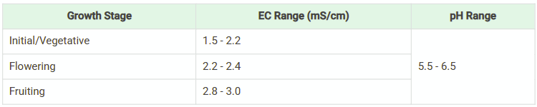
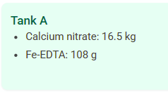
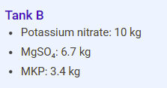
Nutrient Management System Fertigation
Daily Fertigation Schedule
10-13 fertigation cycles during peak growing season.
Automatic controller manages timing based on light intensity.
Typical cycle: 3-5 minutes fertigation, 4-6 times during daylight
Recipe (per 100L water)
EC Requirements by Growth Stage

Slide 18
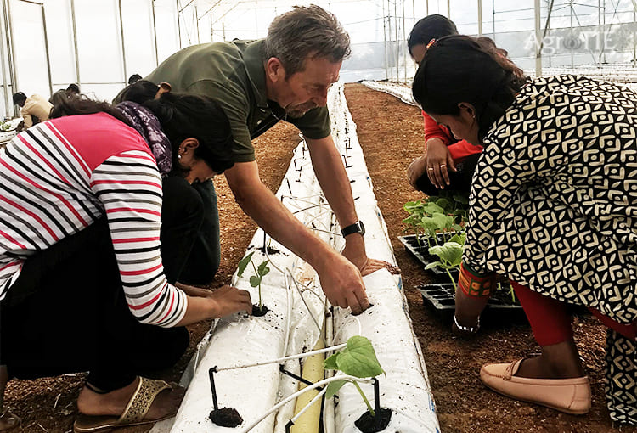
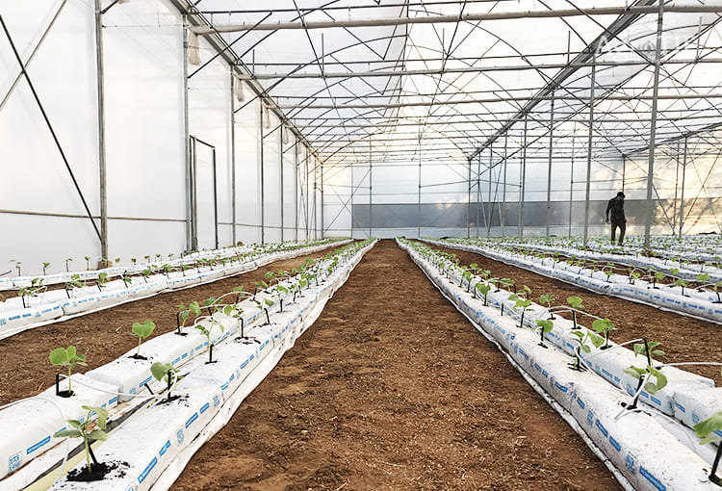
RESULTS

Slide 19
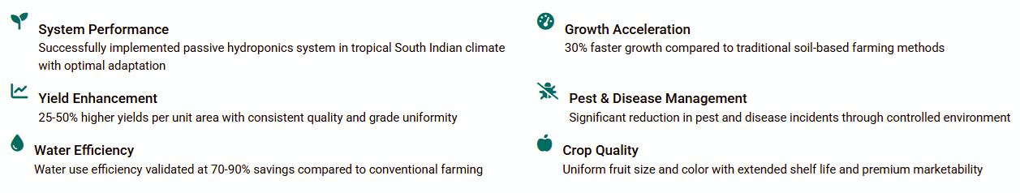
Results & Conclusions
Key Research Findings
The implementation of Dutch hydroponic farming techniques in South India demonstrates successful adaptation of temperate technologies to tropical climates with significant improvements in resource efficiency and yield.
Transformative Impact
The successful implementation of Dutch farming techniques for tomato cultivation in South India demonstrates how advanced agricultural technology can be adapted to local conditions. This approach not only addresses immediate farming challenges but also creates a sustainable model for climate-resilient agriculture with positive environmental impacts through reduced chemical inputs and resource optimization.

Slide 20
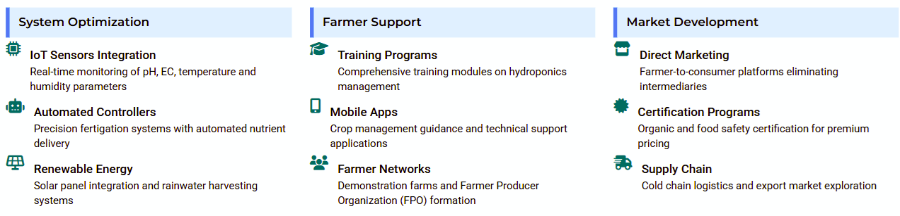
Short-term Recommendations
Implementation Strategy
A phased approach focusing on technology integration, farmer capacity building, and market connections to ensure sustainable adoption of Dutch hydroponic techniques in South India within three years.
Implementation Timeline
The recommended phased approach begins with demonstration projects in Year 1, followed by expansion to early adopters in Year 2, and scaling to commercial operations by Year 3. This gradual implementation ensures proper knowledge transfer, adaptation to local conditions, and sustainable market development for long-term success.

Slide 21
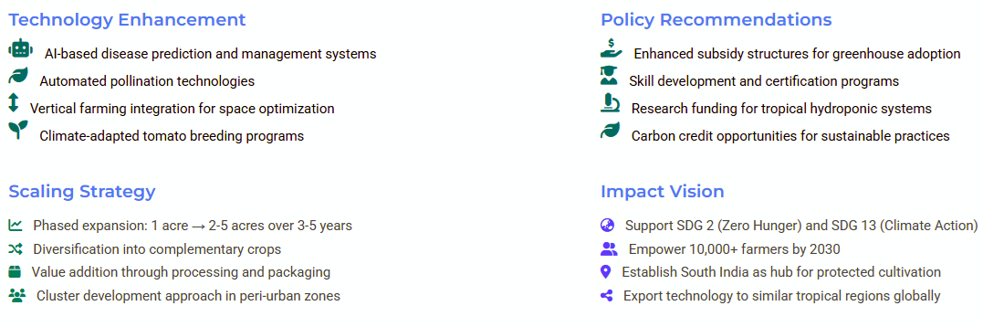
Long-term Vision & Scalability
Future Growth Trajectory
Building on initial implementation success, our vision combines technological innovation, policy advocacy, and regional expansion to transform South Indian agriculture into a sustainable hydroponic hub, serving as a model for other tropical regions.

Slide 22
SWOT ANALYSIS
Strengths | Weaknesses
70-90% water savings compared to traditional farming methods. 8-10x higher productivity per unit area through controlled environment. Premium market prices for clean, pesticide-free produce. No soil-borne diseases due to soilless growing medium | High initial investment compared to traditional farming. Requires technical knowledge and skilled labor for operation. Need for continuous monitoring and maintenance of systems. Limited crop variety compared to open field cultivation.
Opportunities | Threats
Growing urban demand for fresh, safe vegetables. Government subsidies (40-50% through NABARD, MIDH). Export potential for quality produce. Integration with renewable energy (solar). Urban and peri-urban farming expansion. Employment generation for local communities | Power outages affecting climate control systems. Disease outbreaks in closed environment. Market price fluctuations affecting profitability. Competition from established producers. Initial farmer skepticism and adoption barriers. Technical support availability in rural areas.
To conclude, this project proves that technology from temperate countries like the Netherlands can be successfully localized for tropical regions. It offers a practical path toward sustainable farming, conserving resources while improving food quality and farmer livelihoods.
Notes:
To conclude, this project proves that technology from temperate countries like the Netherlands can be successfully localized for tropical regions. It offers a practical path toward sustainable farming, conserving resources while improving food quality and farmer livelihoods.

Slide 23
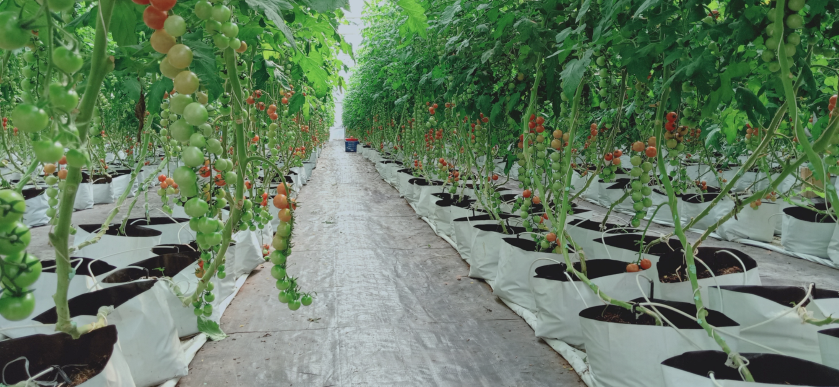
Thank you!
In collaboration with

